Slide 1
Pharmacy Management System QUICK MEDS
Name: Siddiraju Prerana
Batch : PGDDM43

Slide 2
agenda
INTRODUCTION
ABSTRACT
PROBLEM STATMENT
TECHNOLOGIES
SAMPLE OUTPUT
CONCLUSION

Slide 3

INTRODUCTION
The Pharmacy Management System is a comprehensive and user-friendly application specifically designed to streamline and enhance the daily operations of a pharmacy. By leveraging the capabilities of Python's Tkinter library, this system offers a highly intuitive graphical user interface (GUI) that simplifies various complex tasks. It empowers pharmacy staff to efficiently manage essential aspects of the business, including customer details, inventory tracking, and billing processes. The system’s design ensures that all these functions are integrated seamlessly into a single platform, making it easier for staff to maintain accurate records, ensure timely customer service, and optimize overall workflow within the pharmacy.

Slide 4
INTRODUCTION (cont…)
Key Features:
Customer Management: The system allows for easy input and validation of customer details, including name and contact information, ensuring that accurate records are maintained.
Inventory Management: The system features an inventory section where users can add medicines along with their prices. The inventory is dynamically updated, and users can view and manage available medicines.
Order Processing and Billing: The system allows the selection of medicines from the inventory, calculates the total cost including GST (Goods and Services Tax), and generates a detailed bill for the customer. The billing process is simple and automated, reducing the chances of manual errors.
4

Slide 5
INTRODUCTION(cont…)
Past Records Management: The application stores past transaction records in a JSON file, allowing for easy retrieval and review of previous sales. Users can view, and if necessary, delete past records directly from the system.
Data Validation: The system includes data validation mechanisms, such as ensuring the contact number is a valid 10-digit number, to prevent incorrect data entry.
User Interface: The GUI is designed with a focus on usability, featuring clear labels, entry fields, and buttons, making it accessible even for users with minimal technical knowledge.

Slide 6
ABSTRACT
The Pharmacy Management System is a specialized software application developed to optimize and streamline the daily operations of pharmacies. Utilizing Python's Tkinter library, this system provides a user-friendly graphical user interface (GUI) that simplifies the management of customer information, inventory, and billing processes. The system is designed to handle various tasks, such as recording and validating customer details, maintaining and updating inventory in real-time, and automating the billing process with integrated GST calculations. Additionally, it offers robust features for storing and retrieving past transaction records, ensuring accurate and efficient record-keeping. By consolidating these critical functions into a single, intuitive platform, the Pharmacy Management System enhances the efficiency and accuracy of pharmacy operations, making it an invaluable tool for small to medium-sized pharmacies.

Slide 7
PROBLEM STATEMENT
Pharmacies, particularly small to medium-sized establishments, often face challenges in managing day-to-day operations due to the manual handling of customer information, inventory management, and billing processes. This can lead to errors, inefficiencies, and a lack of streamlined workflows, ultimately impacting customer service and business performance. The absence of an integrated system for tracking inventory, processing orders, and maintaining accurate records further exacerbates these issues, making it difficult to manage the pharmacy effectively. Therefore, there is a critical need for a comprehensive and user-friendly management system that can automate and simplify these essential tasks, ensuring accuracy, efficiency, and improved operational performance within the pharmacy.

Slide 8
TECHNOLOGIES
Python Programming Language:
Core Language: Python is the primary programming language used for developing the Pharmacy Management System. It is chosen for its simplicity, readability, and extensive library support, which makes it ideal for rapid development of GUI-based applications.
Tkinter Library:
Graphical User Interface (GUI) Toolkit: Tkinter is a standard GUI toolkit in Python that provides a range of widgets and tools to create interactive desktop applications. It is used to build the user interface of the Pharmacy Management System, including windows, buttons, text fields, and more.

Slide 9
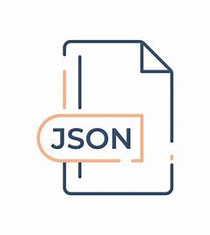
TECHNOLOGIES (cont…)
JSON (JavaScript Object Notation):
Data Storage and Serialization: JSON is used for storing and retrieving past transaction records. It allows the system to save structured data (like customer details and billing records) in a human-readable and easily accessible format, which is essential for data persistence and management.

Slide 10
TECHNOLOGIES(cont…)
Object-Oriented Programming (OOP):
Design Paradigm: The application is structured using object-oriented programming principles. This includes defining classes and objects (e.g., Pharmacy Management System class) to encapsulate data and methods, promoting code reusability, modularity, and easier maintenance.
Python’s Standard Libraries:
os Module: The os module is used for file handling operations, such as checking the existence of the records file (past_records.json) and managing file paths, ensuring compatibility across different operating systems.
messagebox and simpledialog Modules: These modules from Tkinter provide dialogs for user interaction, such as displaying warnings, confirmations, and prompts, enhancing the interactivity and user experience of the application.

Slide 11
TECHNOLOGIES(cont…)
Cross-Platform Compatibility:
Python’s Cross-Platform Nature: Python applications, including those built with Tkinter, are cross-platform, meaning the Pharmacy Management System can run on multiple operating systems (Windows, macOS, Linux) without significant modifications.
7. Validation Techniques:
Input Validation: Various validation techniques are implemented to ensure data integrity, such as checking the format and length of customer contact numbers. This enhances the reliability of the system by preventing invalid data entry.

Slide 12
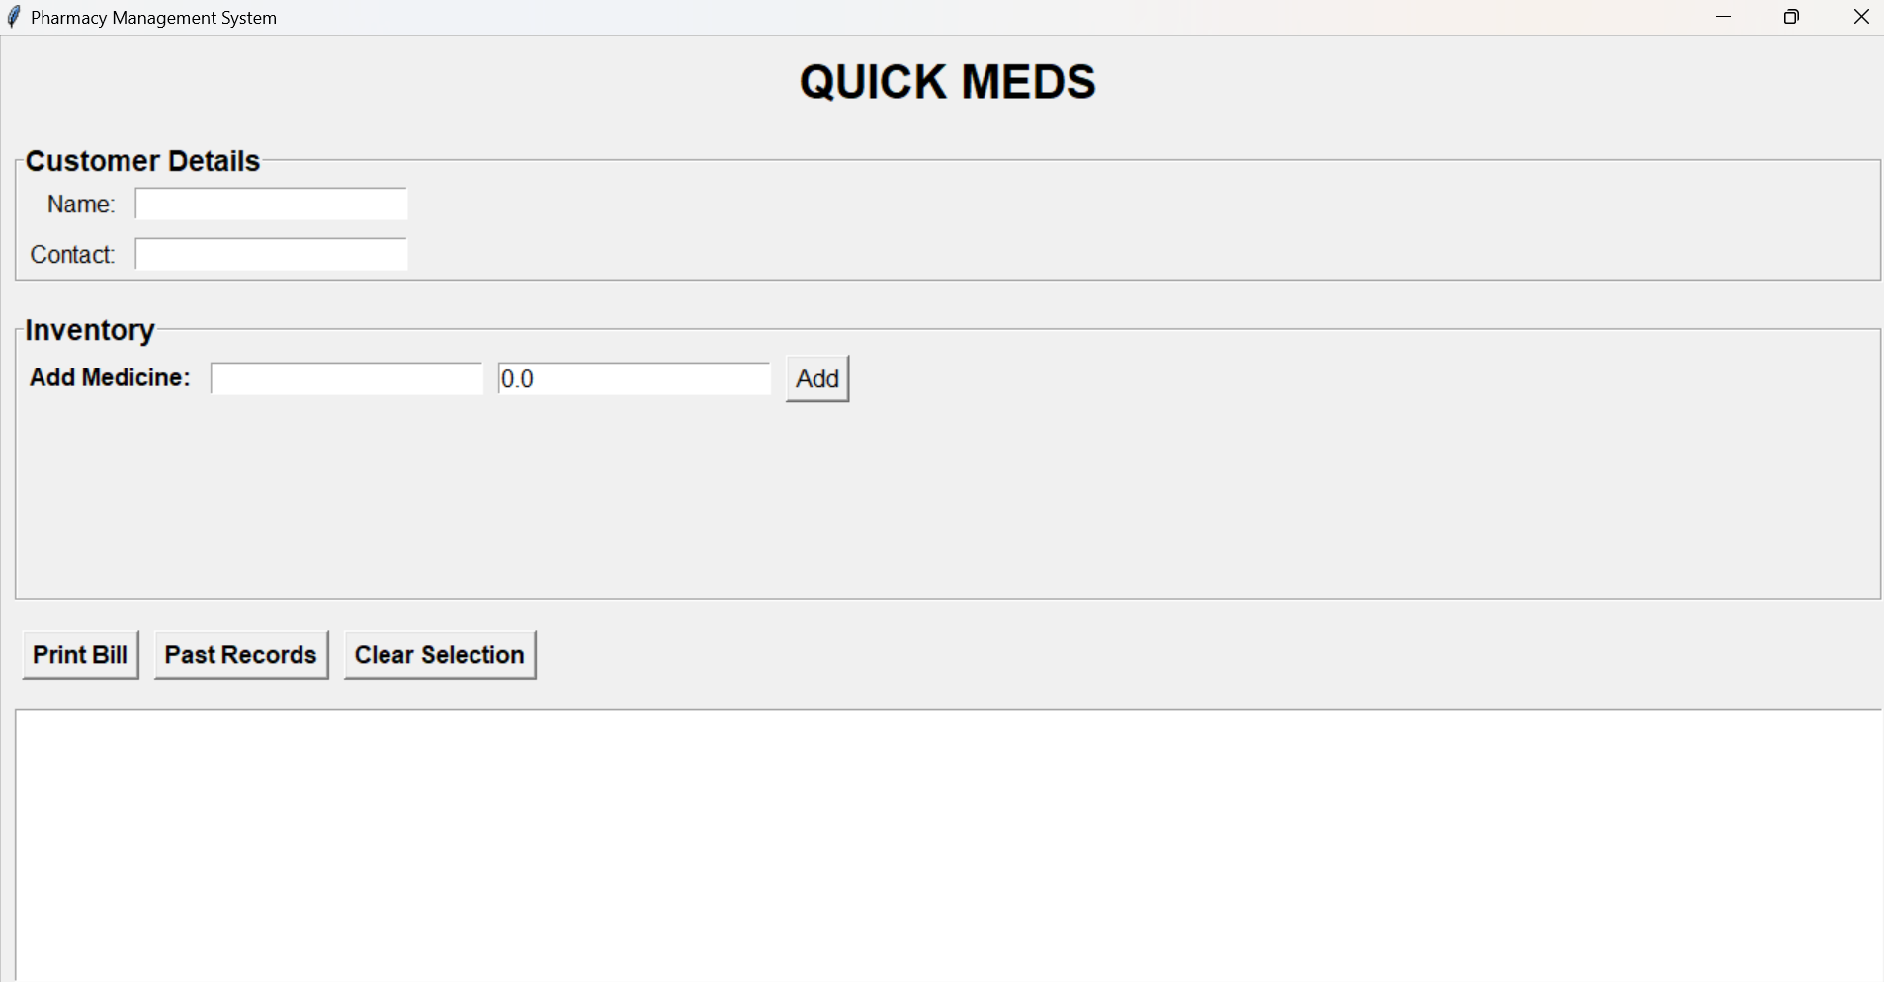
SAMPLE OUTPUT

Slide 13
CONCLUSION
In conclusion, the Pharmacy Management System is a comprehensive and efficient solution designed to address the key challenges faced by small to medium-sized pharmacies. By integrating essential functionalities such as customer management, inventory control, and automated billing into a single, user-friendly platform, the system significantly enhances the accuracy, efficiency, and overall management of daily operations. The use of Python and Tkinter for GUI development ensures that the application is both robust and intuitive, providing pharmacy staff with the tools they need to streamline their workflow, reduce errors, and improve customer service. The system’s ability to handle complex tasks with ease, along with its cross-platform compatibility and data persistence features, makes it an invaluable tool in the modern pharmacy environment. As a result, the Pharmacy Management System not only simplifies operational tasks but also contributes to the overall growth and success of the pharmacy by enabling more effective and reliable business management.

Slide 14
thank you

